Slide 1

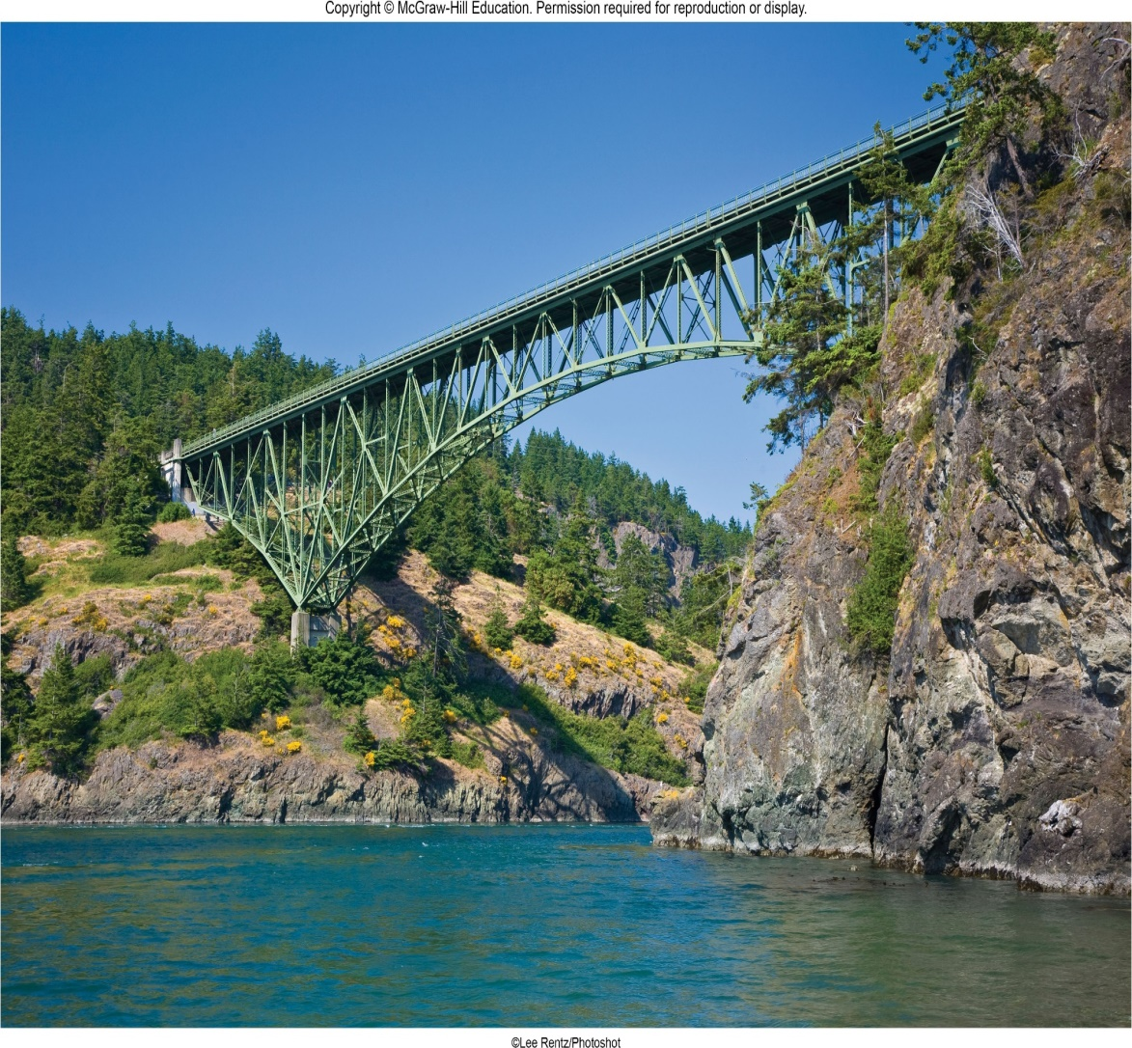
VECTOR MECHANICS FOR ENGINEERS
By: Fardinand P. Beer; E. Russell Johnston, Jr.; David F. Mazurek
ENGINEERING 3120
STATICS
CHAPTER 6
ANALYSIS OF
STRUCTURES
Slides revised by:
A.A. KHANDKER, Ph.D., P.E.
Copyright: McGraw Hill Education

Slide 2
ANALYSIS OF STRUCTURES - TOPICS IN CHAPTER 6
Introduction
Definition of a Truss
Simple Trusses
Analysis of Trusses by the Method of Joints
Joints Under Special Loading Conditions
Space Trusses
Sample Problem 6.1
Analysis of Trusses by the Method of Sections
Trusses Made of Several Simple Trusses
Sample Problem 6.3
Analysis of Frames
Frames Which Cease to be Rigid When Detached From Their Supports
Sample Problem 6.4
Machines

Slide 3
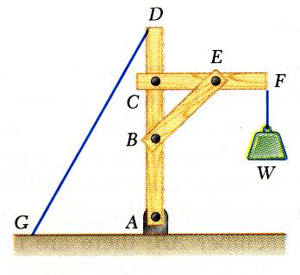
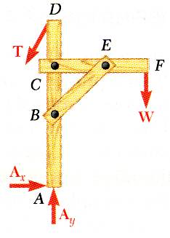
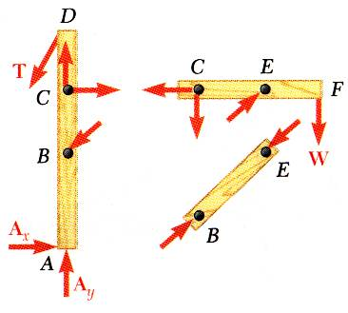
ANALYSIS OF STRUCTURES - INTRODUCTION
For the equilibrium of structures made of several connected parts, the internal forces as well the external forces are considered.
In the interaction between connected parts, Newton’s 3rd Law states that the forces of action and reaction between bodies in contact have the same magnitude, same line of action, and opposite sense.
Three categories of engineering structures are considered:
Frames: contain at least one multi-force member, i.e., member acted upon by 3 or more forces.
Trusses: formed from two-force members, i.e., straight members with end point connections
Machines: structures containing moving parts designed to transmit and modify forces

Slide 4
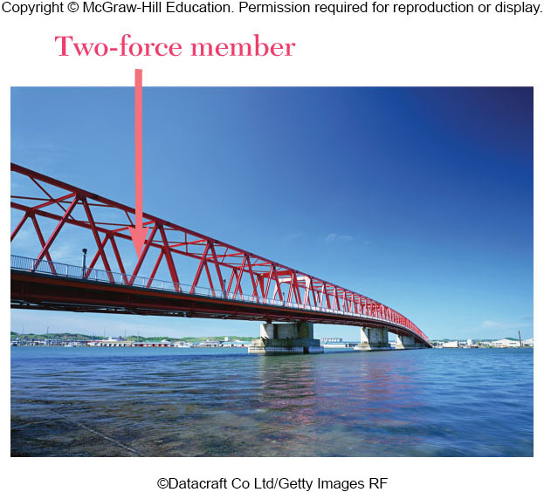
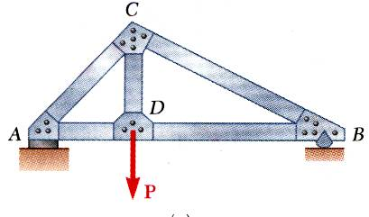
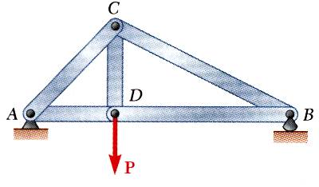
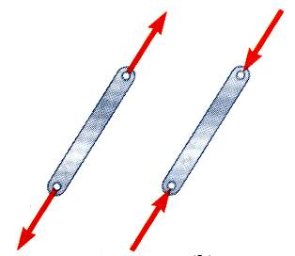
DEFINITION OF A TRUSS
A truss consists of straight members connected at joints. No member is continuous through a joint.
Most structures are made of several trusses joined together to form a space framework. Each truss carries those loads which act in its plane and may be treated as a two-dimensional structure.
Bolted or welded connections are assumed to be pinned together. Forces acting at the member ends reduce to a single force and no couple. Only two-force members are considered.
When forces tend to pull the member apart, it is in tension. When the forces tend to compress the member, it is in compression.

Slide 5
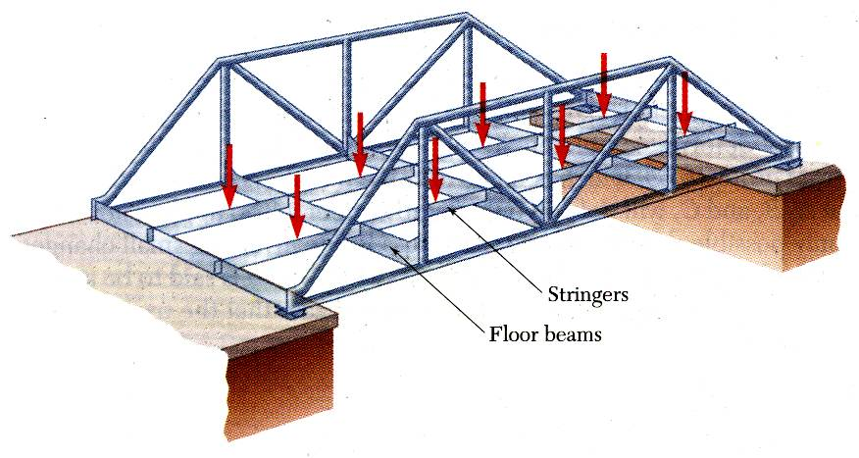
MEMBERS OF A TRUSS
Members of a truss are slender and not capable of supporting large lateral loads. Loads must be applied at the joints.

Slide 6
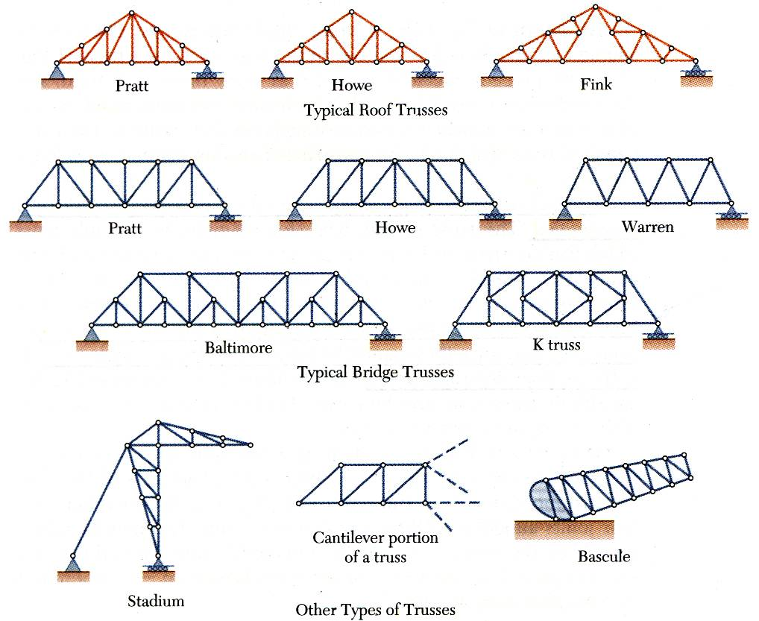
TYPICAL TRUSS CONFIGURATIONS

Slide 7
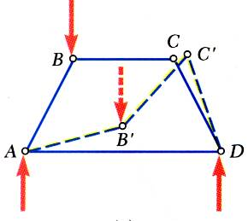
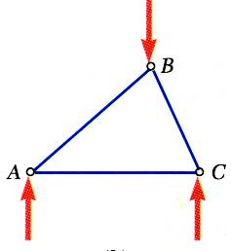
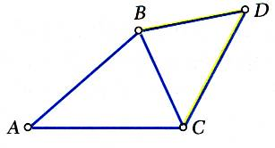
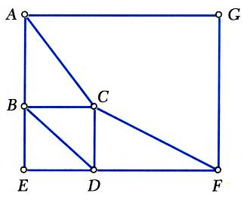
SIMPLE TRUSSES
A rigid truss will not collapse under the application of a load.
A simple truss is constructed by successively adding two members and one connection to the basic triangular truss.
In a simple truss, m = 2n - 3 where m is the total number of members and n is the number of joints.

Slide 8
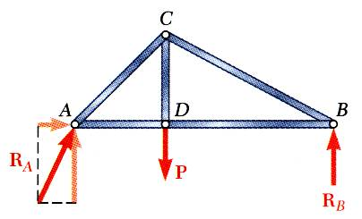
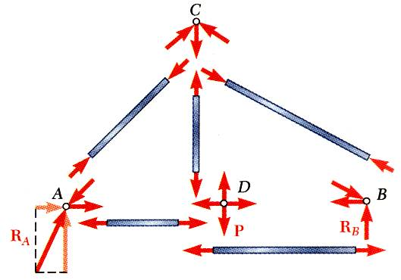
ANALYSIS OF TRUSSES BY SIMPLE METHOD OF JOINTS
Dismember the truss and create a free body diagram for each member and pin.
The two forces exerted on each member are equal, have the same line of action, and opposite sense.
Forces exerted by a member on the pins or joints at its ends are directed along the member and equal and opposite.
Conditions of equilibrium on the pins provide 2n equations for 2n unknowns. For a simple truss, 2n = m + 3. May solve for m member forces and 3 reaction forces at the supports.
Conditions for equilibrium for the entire truss provide 3 additional equations which are not independent of the pin equations.

Slide 9
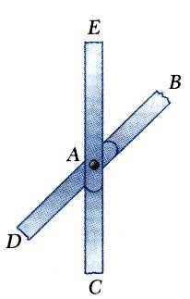
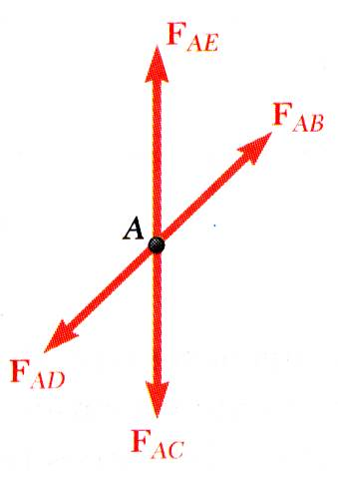
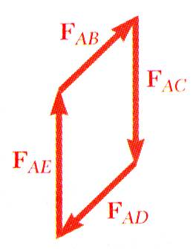
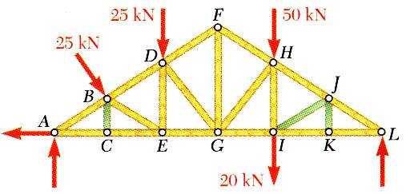
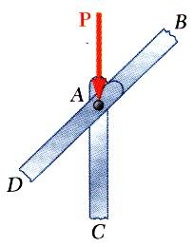
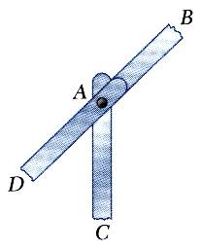
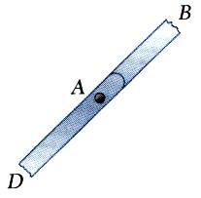
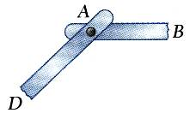
JOINTS UNDER SPECIAL LOADING CONDITIONS
Forces in opposite members intersecting in two straight lines at a joint are equal.
Recognition of joints under special loading conditions simplifies a truss analysis.
The forces in two opposite members are equal when a load is aligned with a third member. The third member force is equal to the load (including zero load).
The forces in two members connected at a joint are equal if the members are aligned and zero otherwise.

Slide 10
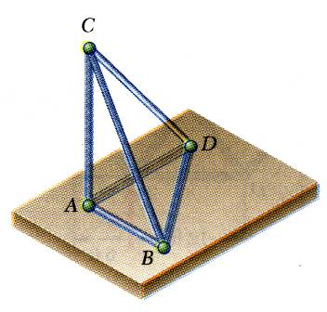
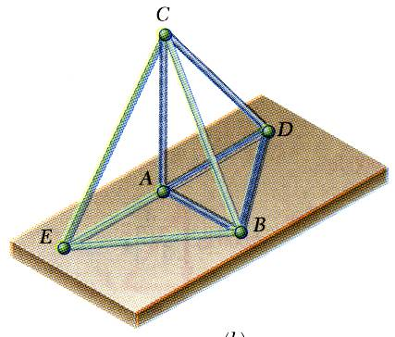
SPACE TRUSSES – 3D TRUSSES
An elementary space truss consists of 6 members connected at 4 joints to form a tetrahedron.
A simple space truss is formed and can be extended when 3 new members and 1 joint are added at the same time.
In a simple space truss, m = 3n - 6 where m is the number of members and n is the number of joints.
Conditions of equilibrium for the joints provide 3n equations. For a simple truss, 3n = m + 6 and the equations can be solved for m member forces and 6 support reactions.
Equilibrium for the entire truss provides 6 additional equations which are not independent of the joint equations.

Slide 11
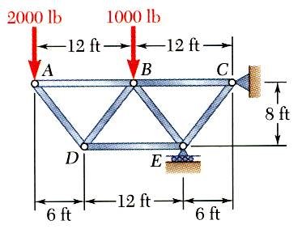
EXAMPLE PROBLEM 6.1
STRATEGY:
Based on a free-body diagram of the entire truss, solve the 3 equilibrium equations for the reactions at E and C.
Joint A is subjected to only two unknown member forces. Determine these from the joint equilibrium requirements.
In succession, determine unknown member forces at joints D, B, and E from joint equilibrium requirements.
All member forces and support reactions are known at joint C. However, the joint equilibrium requirements may be applied to check the results.
Using the method of joints, determine the force in each member of the truss

Slide 12
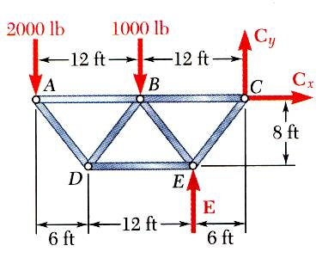
EXAMPLE PROBLEM 6.1 - SOLUTION
MODELING and ANALYSIS
Based on a free-body diagram of the entire truss, solve the 3 equilibrium equations for the reactions at E and C.

Slide 13
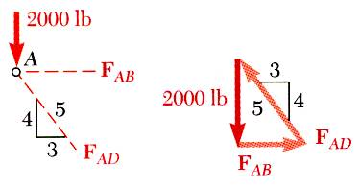
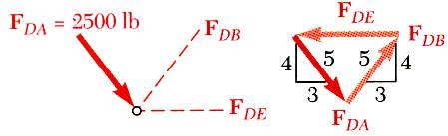
EXAMPLE PROBLEM 6.1 – SOLUTION (continued)
We now solve the problem by moving sequentially from joint to joint and solving the associated FBD for the unknown forces
Joint A or C is subjected to only two unknown member forces. Draw FBD for joint A and determine the two unknown forces from the joint equilibrium requirements.
There are now only two unknown member forces at joint D. Draw FBD at D and solve.

Slide 14
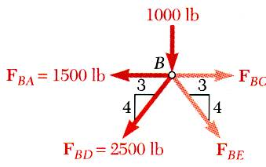
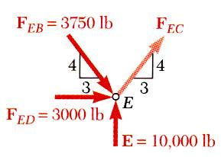
EXAMPLE PROBLEM 6.1 – SOLUTION (continued)
There are now only two unknown member forces at joint B. Assume both are in tension.
There is now one unknown member force at joint E (or C). Use joint E and assume the member EC is in tension.

Slide 15
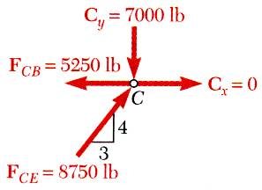
EXAMPLE PROBLEM 6.1 – SOLUTION (continued)
REFLECT and THINK
All member forces and support reactions are known at joint C. However, the joint equilibrium requirements may be applied to check the results.
Using the computed values of F_{CB} and F_{CE}, you can determine the reactions C_{x} and C_{y} by considering the equilibrium
of Joint C.
You can also simply use the computed values of all forces acting on the joint C (forces in members and reactions) and check that the joint is in equilibrium.

Slide 16
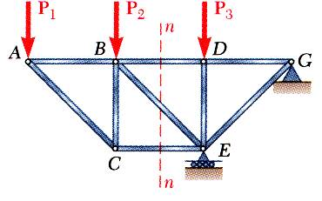
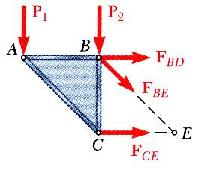
ANLYSIS OF TRUSSES BY THE METHOD OF SECTIONS
When the force in only one member or the forces in a very few members are desired, the method of sections works well.
To determine the force in member BD, form a section by “cutting” the truss at n-n and create a free body diagram for the left side.
An FBD could have been created for the right side, but why is this a less desirable choice? Think and discuss.
Notice that the exposed internal forces are all assumed to be in tension.
With only three members cut by the section, the equations for static equilibrium may be applied to determine the unknown member forces, including F_{BD}.

Slide 17
ANLYSIS OF TRUSSES BY THE METHOD OF SECTIONS
Using the left-side FBD, write one equilibrium equation that can be solved to find F_{BD}. Check your equation with a neighbor; resolve any differences between your answers if you can.
Assume that the initial section cut was made using line k-k. Why would this be a poor choice? Think, then discuss with a neighbor
p
k
p
Notice that any cut may be chosen, so long as the cut creates a separated section
So, for example, this cut with line p-p is acceptable.
k

Slide 18
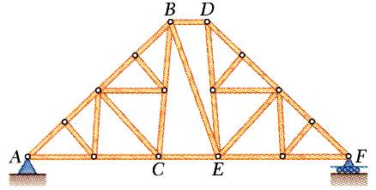
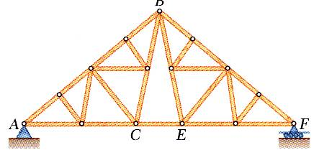
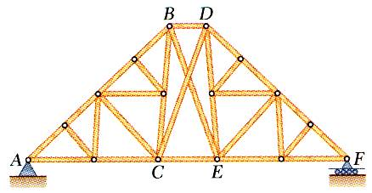
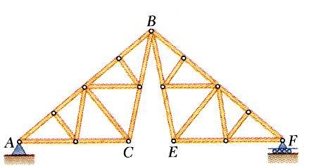
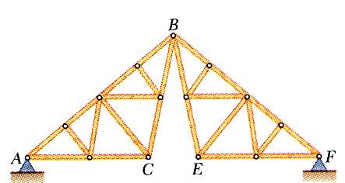
TRUSSES MADE OF SEVERAL SIMPLE TRUSSES
Compound trusses are statically determinant, rigid, and completely constrained.
Truss contains a redundant member and is statically indeterminate.
Additional reaction forces may be necessary for a rigid truss.
Necessary but insufficient condition for a compound truss to be statically determinant, rigid, and completely constrained,
non-rigid
rigid

Slide 19
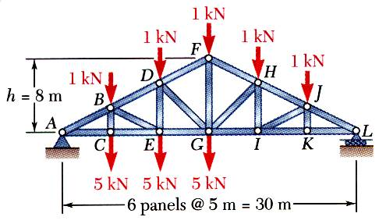
EXAMPLE PROBLEM 6.3
STRATEGY:
Draw the FBD for the entire truss. Apply the equilibrium conditions and solve for the reactions at A and L.
Make a cut through members FH, GH, and GI and take the right-hand section as a free body (the left side would also be good).
Apply the conditions for static equilibrium to determine the desired member forces.
Determine the force in members FH, GH, and GI.

Slide 20
EXAMPLE PROBLEM 6.3 - SOLUTION
Take the entire truss as a free body. Apply the conditions for static equilibrium to solve for the reactions at A and L.

Slide 21
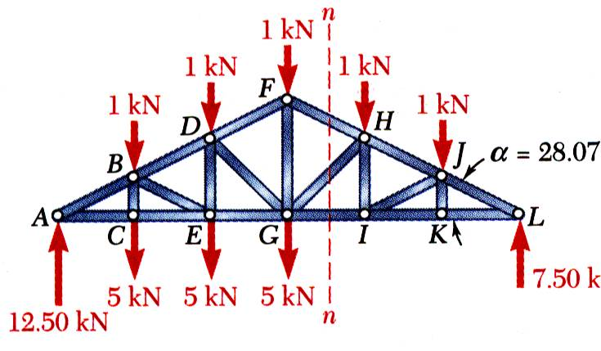
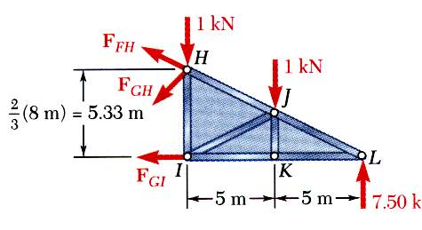
EXAMPLE PROBLEM 6.3 – SOLUTION (continued)
Apply the conditions for static equilibrium to determine the desired member forces.
Make a cut through members FH, GH, and GI and take the right-hand section as a free body. Draw this FBD..

Slide 22
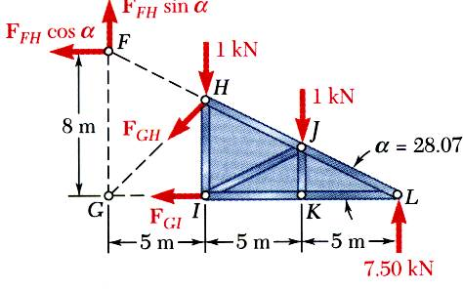
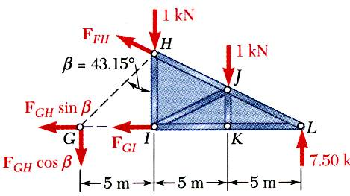
EXAMPLE PROBLEM 6.3 - SOLUTION
REFLECT and THINK:
Resolve a force into components to include it in the equilibrium equations. By first sliding this force along its line of action to a more strategic point, toeliminate one of its components from a moment equilibrium equation.

Slide 23
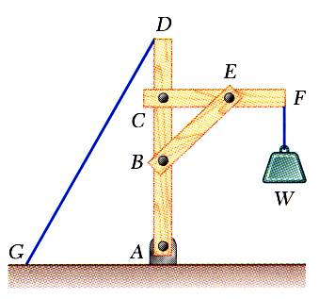
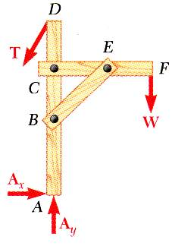
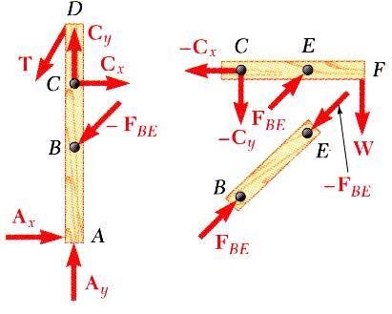
ANALYSIS OF FRAMES
Frames and machines are structures with at least one multiforce member. Frames are designed to support loads and are usually stationary. Machines contain moving parts and are designed to transmit and modify forces.
A free body diagram of the complete frame is used to determine the external forces acting on the frame.
Internal forces are determined by dismembering the frame and creating free-body diagrams for each component.
Forces on two force members have known lines of action but unknown magnitude and sense.
Forces on multi-force members have unknown magnitude and line of action. They must be represented with two unknown components.
Forces between connected components are equal, have the same line of action, and opposite sense.

Slide 24
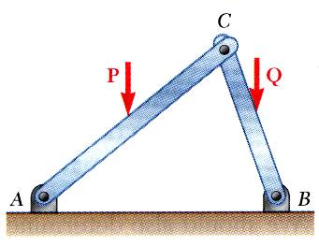
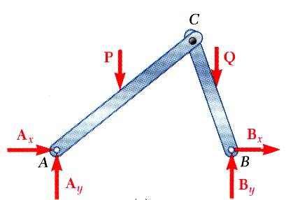

FRAMES WHICH CEASE TO BE RIGID WHEN DETACHED FROM THEIR SUPPORT
Some frames may collapse if removed from their supports. Such frames can not be treated as rigid bodies.
A free-body diagram of the complete frame indicates four unknown force components which can not be determined from the three equilibrium conditions.
The frame must be considered as two distinct, but related, rigid bodies.
With equal and opposite reactions at the contact point between members, the two free-body diagrams indicate 6 unknown force components.
Equilibrium requirements for the two rigid bodies yield 6 independent equations.

Slide 25

EXAMPLE PROBLEM 6.4
STRATEGY:
Create a free-body diagram for the complete frame and solve for the support reactions.
Define a free-body diagram for member BCD. The force exerted by the link DE has a known line of action but unknown magnitude. It is determined by summing moments about C.
With the force on the link DE known, the sum of forces in the x and y directions may be used to find the force components at C.
With member ACE as a free-body, check the solution by summing moments about A.
Members ACE and BCD are connected by a pin at C and by the link DE. For the loading shown, determine the force in link DE and the components of the force exerted at C on member BCD.

Slide 26

EXAMPLE PROBLEM 6.4 - SOLUTION
MODELING and ANALYSIS:
Create a free-body diagram for the complete frame and solve for the support reactions.
Create a free-body diagram for the complete frame and solve for the support reactions.
Note:

Slide 27

EXAMPLE PROBLEM 6.4 – SOLUTION (continued)
Define a free-body diagram for member BCD. The force exerted by the link DE has a known line of action but unknown magnitude. It is determined by summing moments about C.
Sum of forces in the x and y directions may be used to find the force components at C.

Slide 28

EXAMPLE PROBLEM 6.4 – SOLUTION (continued)
With member ACE as a free-body, check the solution by summing moments about A.
(checks)

Slide 29



MACHINES
Machines are structures designed to transmit and modify forces. Their main purpose is to transform input forces into output forces.
Given the magnitude of P, determine the magnitude of Q.
Create a free-body diagram of the complete machine, including the reaction that the wire exerts.
The machine is a nonrigid structure. Use one of the components as a free-body.
Taking moments about A,
End of Chapter 6

